Slide 1

DriverPass System Analysis
Corey Harvey
Notes:
[No speaker notes required for this slide.]

Slide 2

System Requirements
Functional requirements: User Authentication Appointment Scheduling
Non-functional requirements: Performance Security
Notes:
User authentication: This ensures that the users and DriverPass is protected from a data breach with a secure login, registration, and account management settings.
Appointment scheduling: The appointment scheduling feature allows customers to schedule times without the needed stress and load of doing it manually with employees. This streamlines the appointments for DriverPass.
Performance: By practicing resource control and good programming practices, you can ensure that DriverPass will be running smoothly, even under load from users.
Security:
This includes admin control over users who might violate terms of service. This can be used to protect sensitive company and user data.

Slide 3
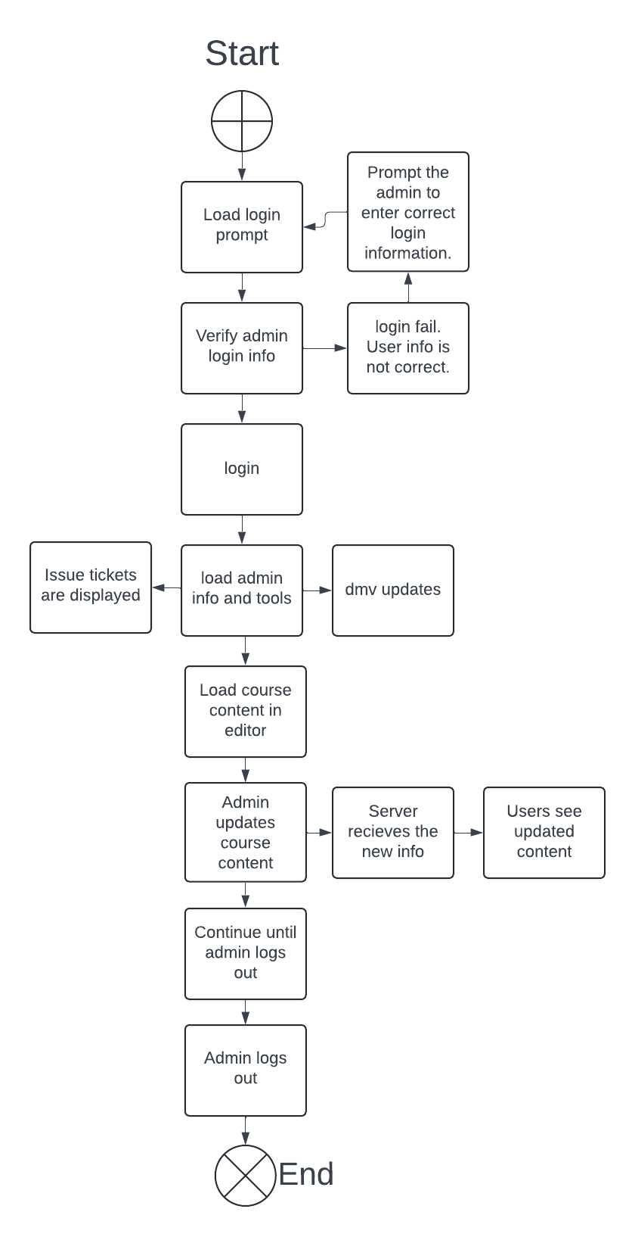
Use Case Diagram
Notes:
The actors show and consist of the different user types, this time, specifically, the admin. The admin is in charge of maintaining different parts of DriverPass. You can see a chart of the tools that the admin can see like being able to view the trouble tickets that they will use to find and fix issues submitted by users or automation. The admin here in this use case is able to login and upload or update course material based on a DMV regulation change. The different use cases consist of logging in or failing to provide proper login info and updating the course material.

Slide 4
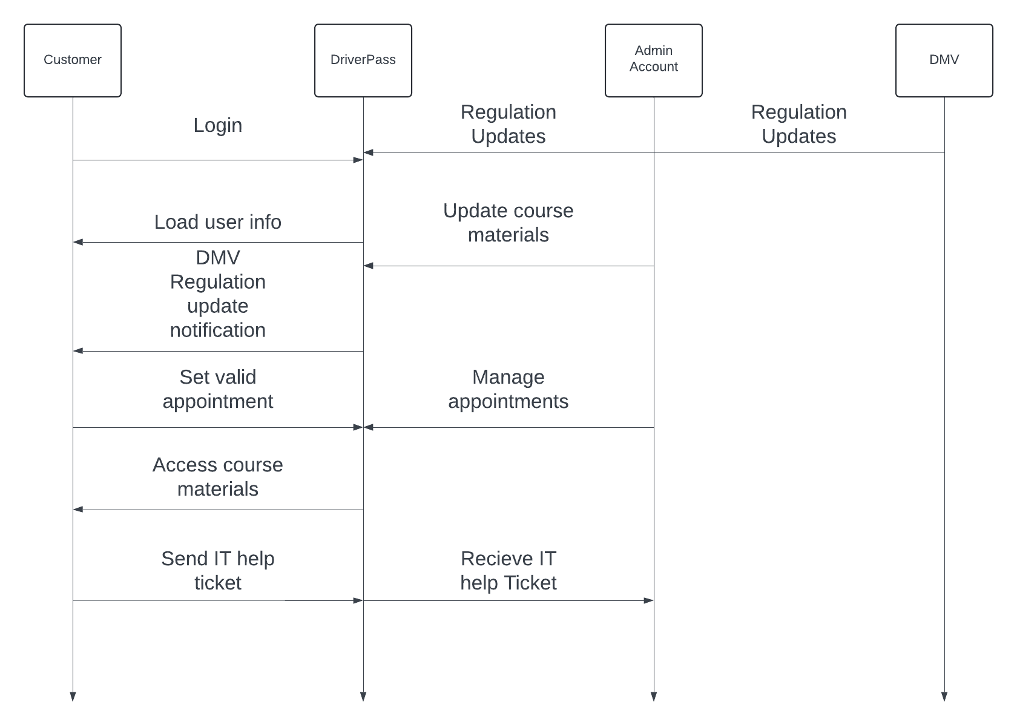
Activity Diagram
Notes:
This use case covers the general jobs of the admin and how he interacts and supports the customer, even if not directly. The admin is able to manage appointments in the even of an issue, receive and work on help tickets, along with update course materials and view updates from the DMV. I was able to account for DriverPass’s needs by double checking the detailed requirements collected earlier in the month. Charts are much easier to create when you have the requirements prepared beforehand. Doing this is also much more thorough.

Slide 5
Security
User authentication
Encryption
User access control
Framework for adding security updates
Notes:
We were adamant on adding proper security. User account control is a must. If we are to provide a paid service, a user account is unavoidable, and since we don’t want any user to modify the site’s data, we employed user security to ensure that isn’t an issue. There will be different user types that will control different parts of Driverpass including an admin and customer account type. Encryption is needed to ensure that no one is able to obtain sensitive site information. We don’t want to cause a data breach. This puts user’s information at risk like passwords and payment information. If everything is encrypted, this will not be an issue.
We kept scalability in mind when creating DriverPass. By building with an ever changing future in mind, we can ensure that DriverPass stays running for a very long time. Since we can now easily change DriverPass on the fly without downtime, we can make sure the customers are secure from exploits, DriverPass won’t succumb to a massive tech change, and company data is safe.

Slide 6
System Limitations
High traffic and system overload
Downtime
System or hardware failure
Customer’s internet performance
Online only service
Notes:
The most limiting factor of DriverPass is that it is online only, but considering it is a service that requires communication, it is unavoidable. It will be usable on site as all local systems should be running. This brings me to another limitation, popularity. If we get too many people logging into DriverPass, the server will be under load and slow down for everyone. This can cause downtime, and excessive strain on the server over time will cause hardware failure. This can be fixed by keeping hardware ready to act as the replacement in the event of hardware failure while the issue is fixed. One last issue is the performance of the user’s internet. DriverPass needs to not use much internet to keep load low and customers with all internet connection speeds connected. If DriverPass has high customer internet requirements, it will not work for everyone.

